Slide 1
Module 7:
Video Action Recognition
1
May 4, 2023

Slide 2

Recall: (2D) Image classification
(assume given a set of possible labels)
{dog, cat, truck, plane, ...}
cat
May 4, 2023

Slide 3
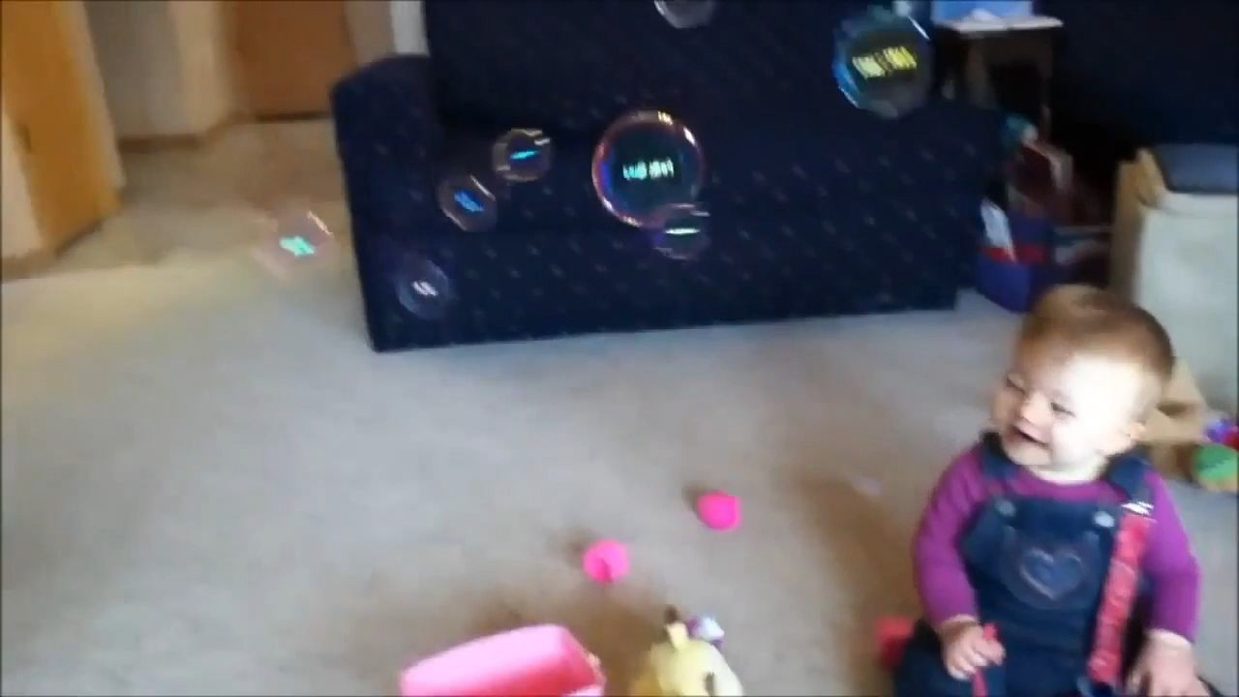

Fei-Fei Li, Yunzhu Li, Ruohan Gao
Lecture 10 -
May 4, 2023

Slide 4
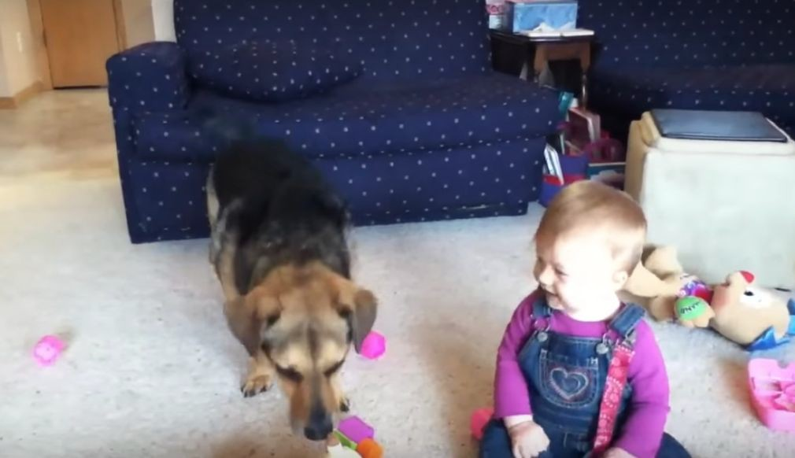
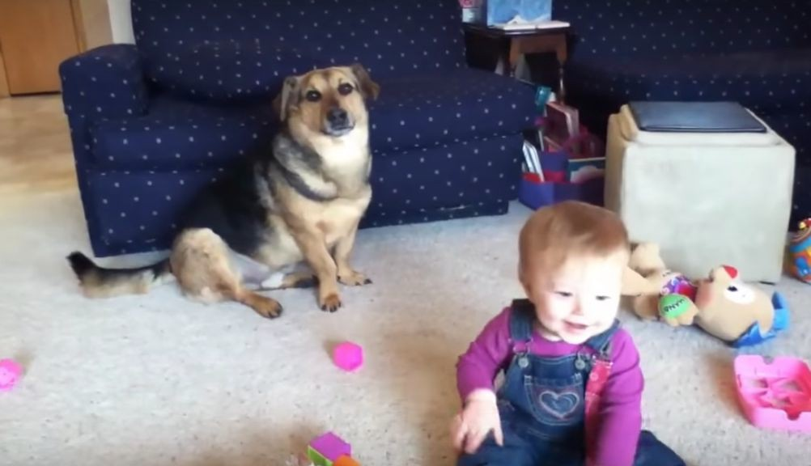
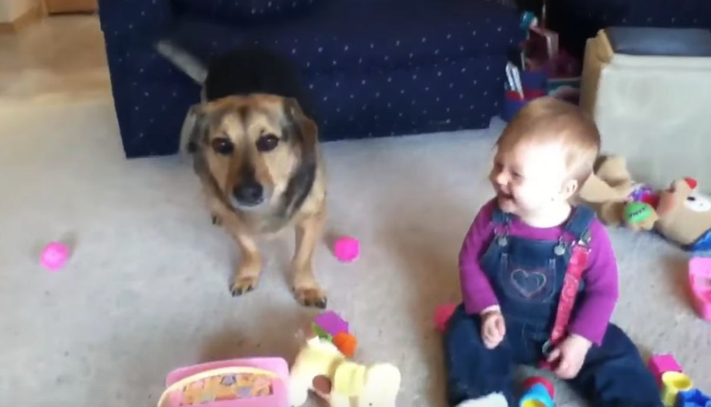
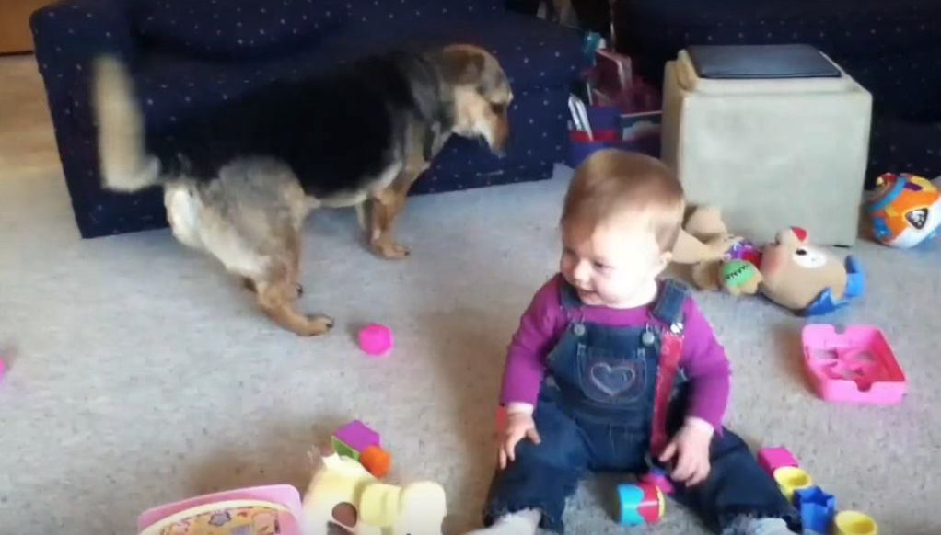
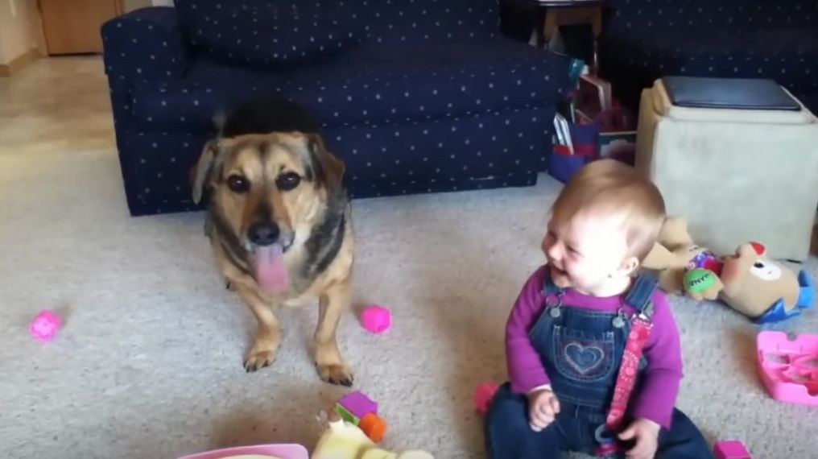
Today: Video = 2D + Time
A video is a sequence of images 4D tensor: T x 3 x H x W
(or 3 x T x H x W)
…
…
9
May 4, 2023

Slide 5
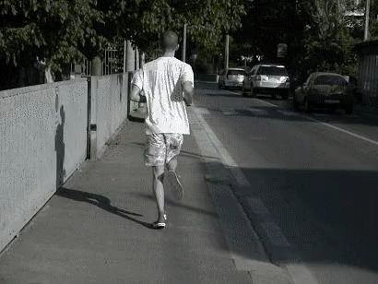
Example task: Video Classification
Swimming Running Jumping Eating Standing
Input video: T x 3 x H x W

Slide 6
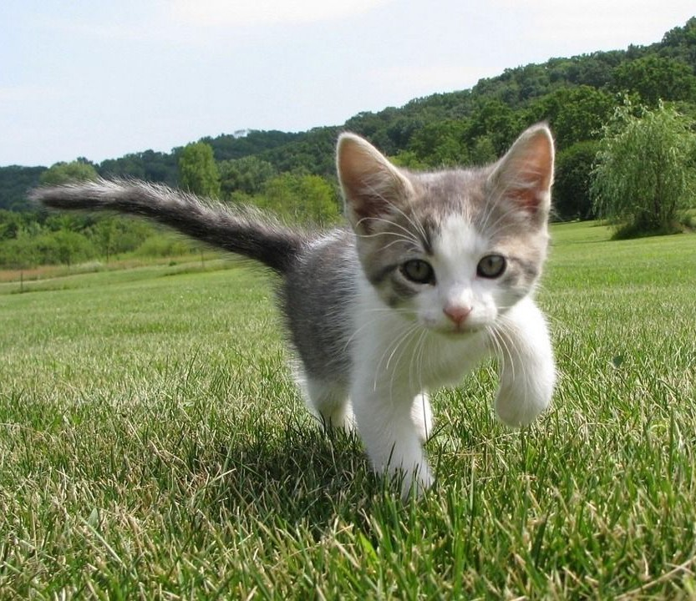
Example task: Video Classification
Dog Cat Fish Truck
Images: Recognize objects
Swimming Videos: Recognize actions _{Running}
Jumping Eating Standing

Slide 7
Problem: Videos are big!
Videos are ~30 frames per second (fps)
Size of uncompressed video (3 bytes per pixel):
SD (640 x 480): ~1.5 GB per minute
HD (1920 x 1080): ~10 GB per minute
Input video:
T x 3 x H x W

Slide 8
Problem: Videos are big!
Videos are ~30 frames per second (fps)
Size of uncompressed video (3 bytes per pixel):
SD (640 x 480): ~1.5 GB per minute
HD (1920 x 1080): ~10 GB per minute
Solution: Train on short clips: low fps and low spatial resolution
e.g. T = 16, H=W=112
(3.2 seconds at 5 fps, 588 KB)
Input video: T x 3 x H x W

Slide 9
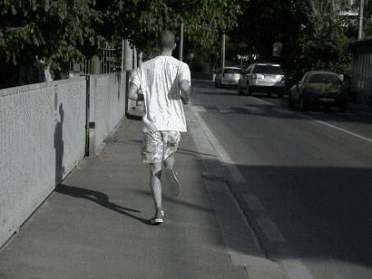
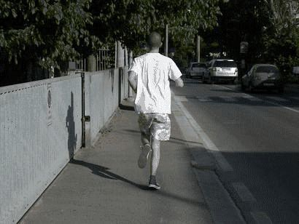
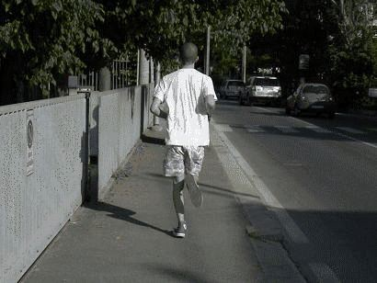
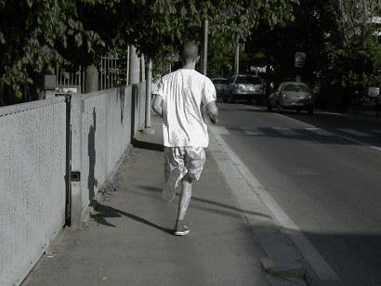
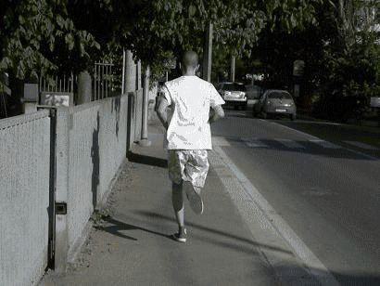
Training on Clips
Raw video: Long, high FPS

Slide 10
Training on Clips
Raw video: Long, high FPS
Training: Train model to classify short clips with low FPS

Slide 11
Training on Clips
Raw video: Long, high FPS
Training: Train model to classify short clips with low FPS
Testing: Run model on different clips, average predictions

Slide 12
Video Classification: Single-Frame CNN
Simple idea: train normal 2D CNN to classify video frames independently! (Average predicted probs at test-time)
Often a very strong baseline for video classification
“Running” “Running” “Running” “Running” “Running” “Running”
CNN CNN CNN CNN CNN CNN
“Running”
CNN

Slide 13
Video Classification: Late Fusion (with FC layers)
Intuition: Get high-level appearance of each frame, and combine them
Class scores: C
Run 2D CNN on each frame, concatenate features and feed to MLP
Clip features: TDH’W’
MLP
Flatten
Frame features T x D x H’ x W’
2D CNN
on each frame
CNN CNN CNN CNN CNN CNN
Input:
T x 3 x H x W
Karpathy et al, “Large-scale Video Classification with Convolutional Neural Networks”, CVPR 2014

Slide 14
Video Classification: Late Fusion (with pooling)
Run 2D CNN on each frame, pool features and feed to Linear
Intuition: Get high-level appearance of each frame, and combine them
Class scores: C
Linear
Clip features: D
Average Pool over space and time
Frame features T x D x H’ x W’
2D CNN
on each frame
CNN CNN CNN CNN CNN CNN
Input:
T x 3 x H x W

Slide 15



Video Classification: Late Fusion (with pooling)
Intuition: Get high-level
Run 2D CNN on each frame, pool features and feed to Linear
appearance of each frame, and combine them
Problem: Hard to compare
Class scores: C
Linear
low-level motion between framesClip features: D
Average Pool over space and time
Frame features T x D x H’ x W’
2D CNN
on each frame
CNN CNN CNN CNN CNN CNN
Input:
T x 3 x H x W

Slide 16




Video Classification: Early Fusion
Intuition: Compare frames with very first conv layer,
after that normal 2D CNN
Class scores: C
Rest of the network is standard 2D CNN
First 2D convolution collapses all temporal information:
Input: 3T x H x W
Output: D x H x W
2D CNN
Reshape: 3T x H x W
Input:
T x 3 x H x W
Karpathy et al, “Large-scale Video Classification with Convolutional Neural Networks”, CVPR 2014

Slide 17
Video Classification: Early Fusion
Intuition: Compare frames with very first conv layer, after that normal 2D CNN
Problem: One layer of temporal processing may not be enough!
First 2D convolution collapses all temporal information:
Input: 3T x H x W
Class scores: C
Rest of the network is standard 2D CNN
2D CNN
Reshape:
Output: D x H x W
3T x H x W
Input:
T x 3 x H x W
Karpathy et al, “Large-scale Video Classification with Convolutional Neural Networks”, CVPR 2014

Slide 18

Video Classification: 3D CNN
Intuition: Use 3D versions of convolution and pooling to slowly fuse temporal
information over the course of the network
Class scores: C
Each layer in the network is a 4D tensor: D x T x H x W Use 3D conv and 3D pooling operations
3D CNN
Input:
3 x T x H x W
Ji et al, “3D Convolutional Neural Networks for Human Action Recognition”, TPAMI 2010 ; Karpathy et al, “Large-scale Video Classification with Convolutional Neural Networks”, CVPR 2014
Slide credit: Justin Johnson
May 4, 2023

Slide 19
Convolution Layer
activation map
32x32x3 image 5x5x3 filter
32
28
convolve (slide) over all spatial locations
32
28
3
1
May 4, 2023

Slide 20
3D Convolution
6x6x6 conv
5x5x5 conv
4x4x4 conv
Input:
C x T x H x W
Class Scores
FC
Layer
May 4, 2023

Slide 21


2D Conv (Early Fusion) vs 3D Conv (3D CNN)
Input: C x T x H x W
Weight:
Output:
in
C x C x T x 3 x 3
C x H x W
(3D grid with C_{in}-dim feat at each point)
out
out in
2D grid with C_{out} – dim feat at each point
Slide over x and y
H = 224
T = 16
H = 224
T = 16
^{C}out
different filters
W = 224
Fei-Fei Li, Yunzhu Li, Ruohan Gao
W = 224
May 4, 2023

Slide 22
2D Conv (Early Fusion) vs 3D Conv (3D CNN)
Input: C x T x H x W
Weight:
Output:
in
C x C x T x 3 x 3
C x H x W
(3D grid with C_{in}-dim feat at each point)
out in
out
Slide over x and y
No temporal shift-invariance! Needs to learn separate filters for the same motion at different times in the clip
2D grid with C_{out} –dim feat at each point
H = 224
C_{out} different filters
T = 16
W = 224
Fei-Fei Li, Yunzhu Li, Ruohan Gao
W = 224
May 4, 2023

Slide 23
2D Conv (Early Fusion) vs 3D Conv (3D CNN)
Input: C x T x H x W
Weight:
Output:
in
C x C x T x 3 x 3
C x H x W
(3D grid with C_{in}-dim feat at each point)
out in
out
Slide over x and y
No temporal shift-invariance! Needs to learn separate filters for the same motion at different times in the clip
2D grid with C_{out} –dim feat at each point
H = 224
C_{out} different filters
T = 16
How to recognize blue to orange
transitions anywhere in space and time?
W = 224
W = 224
May 4, 2023

Slide 24

2D Conv (Early Fusion) vs 3D Conv (3D CNN)
Input: C x T x H x W
Weight:
Output:
in
C x T x H x W
(3D grid with C_{in}-dim feat at each point)
C x C x 3 x 3 x 3
out in
out
Slide over x and y
3D grid with C_{out}–dim feat at each point
H = 224
H = 224
T = 3
^{C}out
different filters
T = 16
How to recognize blue to orange
transitions anywhere in space and time?
W = 224
W = 224
May 4, 2023

Slide 25
2D Conv (Early Fusion) vs 3D Conv (3D CNN)
Input: C x T x H x W
Weight:
Output:
in
C x T x H x W
(3D grid with C_{in}-dim feat at each point)
C x C x 3 x 3 x 3
out in
out
Slide over x and y
Temporal shift-invariant since each filter slides over time!
3D grid with C_{out}–dim feat at each point
H = 224
H = 224
T = 3
^{C}out
different filters
T = 16
How to recognize blue to orange
transitions anywhere in space and time?
W = 224
W = 224
May 4, 2023

Slide 26
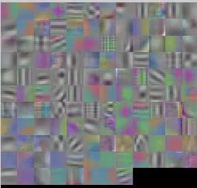
2D Conv (Early Fusion) vs 3D Conv (3D CNN)
Input: C_{in} x T x H x W (3D grid with C_{in}-dim feat at each point)
Weight:
C_{out} x C_{in} x 3 x 3 x 3 Slide over x and y
Temporal shift-invariant since each filter slides over time!
First-layer filters have shape 3 (RGB) x 4 (frames) x 5 x 5 (space)
Can visualize as video clips!
H = 224
T = 3
_{T = 16} C_{out} different filters
How to recognize blue to orange
W = 224
transitions anywhere in space and time?

Slide 27
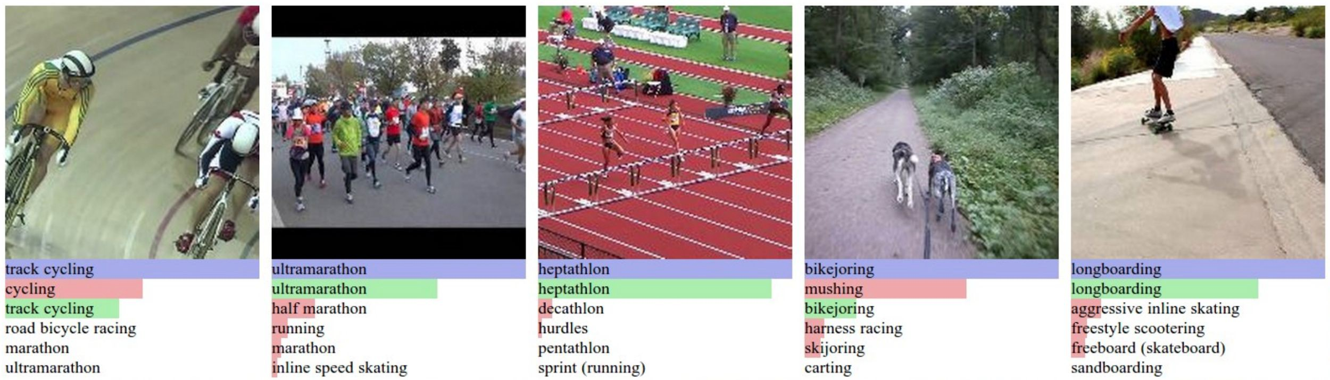
Example Video Dataset: Sports-1M
1 million YouTube videos annotated with labels for 487 different types of sports
Ground Truth Correct prediction Incorrect prediction
Karpathy et al, “Large-scale Video Classification with Convolutional Neural Networks”, CVPR 2014

Slide 28
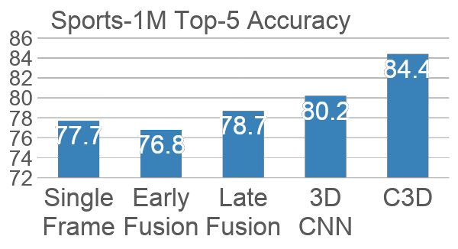
Early Fusion vs Late Fusion vs 3D CNN
Single Frame model works well – always try this first!
3D CNNs have improved a lot since 2014!
Karpathy et al, “Large-scale Video Classification with Convolutional Neural Networks”, CVPR 2014

Slide 29
C3D: The VGG of 3D CNNs
Layer | Size
Input | 3 x 16 x 112 x 112
Conv1 (3x3x3) | 64 x 16 x 112 x 112
Pool1 (1x2x2) | 64 x 16 x 56 x 56
Conv2 (3x3x3) | 128 x 16 x 56 x 56
Pool2 (2x2x2) | 128 x 8 x 28 x 28
Conv3a (3x3x3) | 256 x 8 x 28 x 28
Conv3b (3x3x3) | 256 x 8 x 28 x 28
Pool3 (2x2x2) | 256 x 4 x 14 x 14
Conv4a (3x3x3) | 512 x 4 x 14 x 14
Conv4b (3x3x3) | 512 x 4 x 14 x 14
Pool4 (2x2x2) | 512 x 2 x 7 x 7
Conv5a (3x3x3) | 512 x 2 x 7 x 7
Conv5b (3x3x3) | 512 x 2 x 7 x 7
Pool5 | 512 x 1 x 3 x 3
FC6 | 4096
FC7 | 4096
FC8 | C
3D CNN that uses all 3x3x3 conv and 2x2x2 pooling
(except Pool1 which is 1x2x2)
Released model pretrained on Sports-1M: Many people used this as a video feature extractor
Tran et al, “Learning Spatiotemporal Features with 3D Convolutional Networks”, ICCV 2015
May 4, 2023

Slide 30
C3D: The VGG of 3D CNNs
Layer | Size | MFLOPs
Input | 3 x 16 x 112 x 112
Conv1 (3x3x3) | 64 x 16 x 112 x 112 | 1.04
Pool1 (1x2x2) | 64 x 16 x 56 x 56
Conv2 (3x3x3) | 128 x 16 x 56 x 56 | 11.10
Pool2 (2x2x2) | 128 x 8 x 28 x 28
Conv3a (3x3x3) | 256 x 8 x 28 x 28 | 5.55
Conv3b (3x3x3) | 256 x 8 x 28 x 28 | 11.10
Pool3 (2x2x2) | 256 x 4 x 14 x 14
Conv4a (3x3x3) | 512 x 4 x 14 x 14 | 2.77
Conv4b (3x3x3) | 512 x 4 x 14 x 14 | 5.55
Pool4 (2x2x2) | 512 x 2 x 7 x 7
Conv5a (3x3x3) | 512 x 2 x 7 x 7 | 0.69
Conv5b (3x3x3) | 512 x 2 x 7 x 7 | 0.69
Pool5 | 512 x 1 x 3 x 3
FC6 | 4096 | 0.51
FC7 | 4096 | 0.45
FC8 | C | 0.05
3D CNN that uses all 3x3x3 conv and 2x2x2 pooling
(except Pool1 which is 1x2x2)
Released model pretrained on Sports-1M: Many people used this as a video feature extractor
Problem: 3x3x3 conv is very expensive!
AlexNet: 0.7 GFLOP
VGG-16: 13.6 GFLOP
C3D: 39.5 GFLOP (2.9x VGG!)
Tran et al, “Learning Spatiotemporal Features with 3D Convolutional Networks”, ICCV 2015
Fei-Fei Li, Yunzhu Li, Ruohan Gao

Slide 31
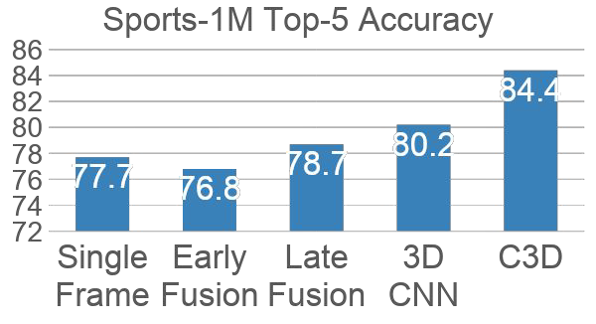
Early Fusion vs Late Fusion vs 3D CNN
Karpathy et al, “Large-scale Video Classification with Convolutional Neural Networks”, CVPR 2014
Tran et al, “Learning Spatiotemporal Features with 3D Convolutional Networks”, ICCV 2015

Slide 32
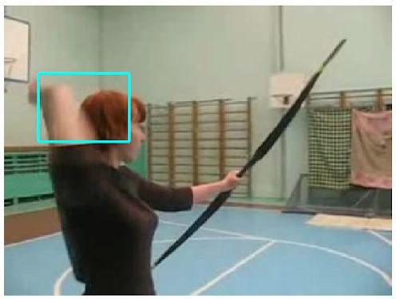
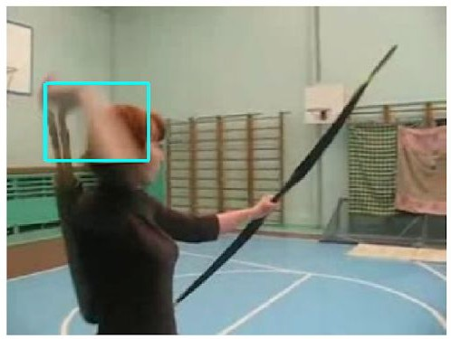
Measuring Motion: Optical Flow
Image at frame t
Image at frame t+1
Simonyan and Zisserman, “Two-stream convolutional networks for action recognition in videos”, NeurIPS 2014
Fei-Fei Li, Yunzhu Li, Ruohan Gao

Slide 33
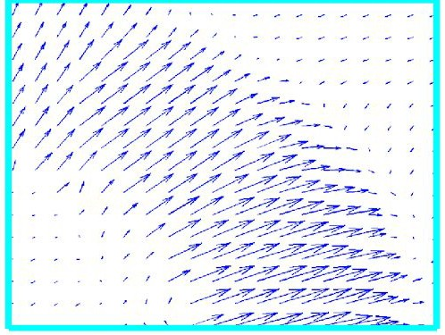
Measuring Motion: Optical Flow
Optical flow gives a
Image at frame t
displacement field F between images I_{t} and I_{t+1}
Tells where each pixel will move in the next frame: F(x, y) = (dx, dy) I_{t+1}(x+dx, y+dy) = I_{t}(x, y)
Image at frame t+1
Simonyan and Zisserman, “Two-stream convolutional networks for action recognition in videos”, NeurIPS 2014
Fei-Fei Li, Yunzhu Li, Ruohan Gao

Slide 34
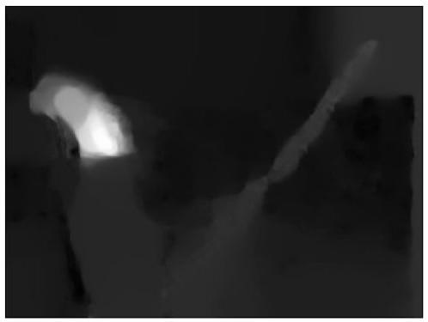
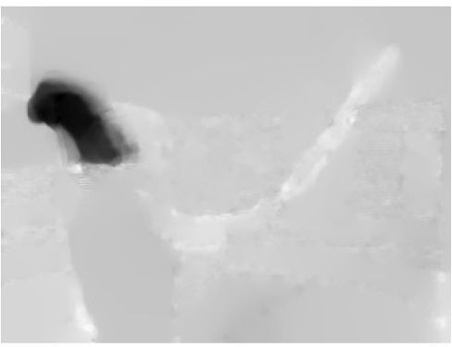
Optical Flow highlights
Measuring Motion: Optical Flow
Optical flow gives a
local motion
Horizontal flow dx
Image at frame t
displacement field F between images I_{t} and I_{t+1}
Tells where each pixel will move in the next frame: F(x, y) = (dx, dy) I_{t+1}(x+dx, y+dy) = I_{t}(x, y)
Image at frame t+1
Vertical Flow dy
Simonyan and Zisserman, “Two-stream convolutional networks for action recognition in videos”, NeurIPS 2014
Fei-Fei Li, Yunzhu Li, Ruohan Gao

Slide 35
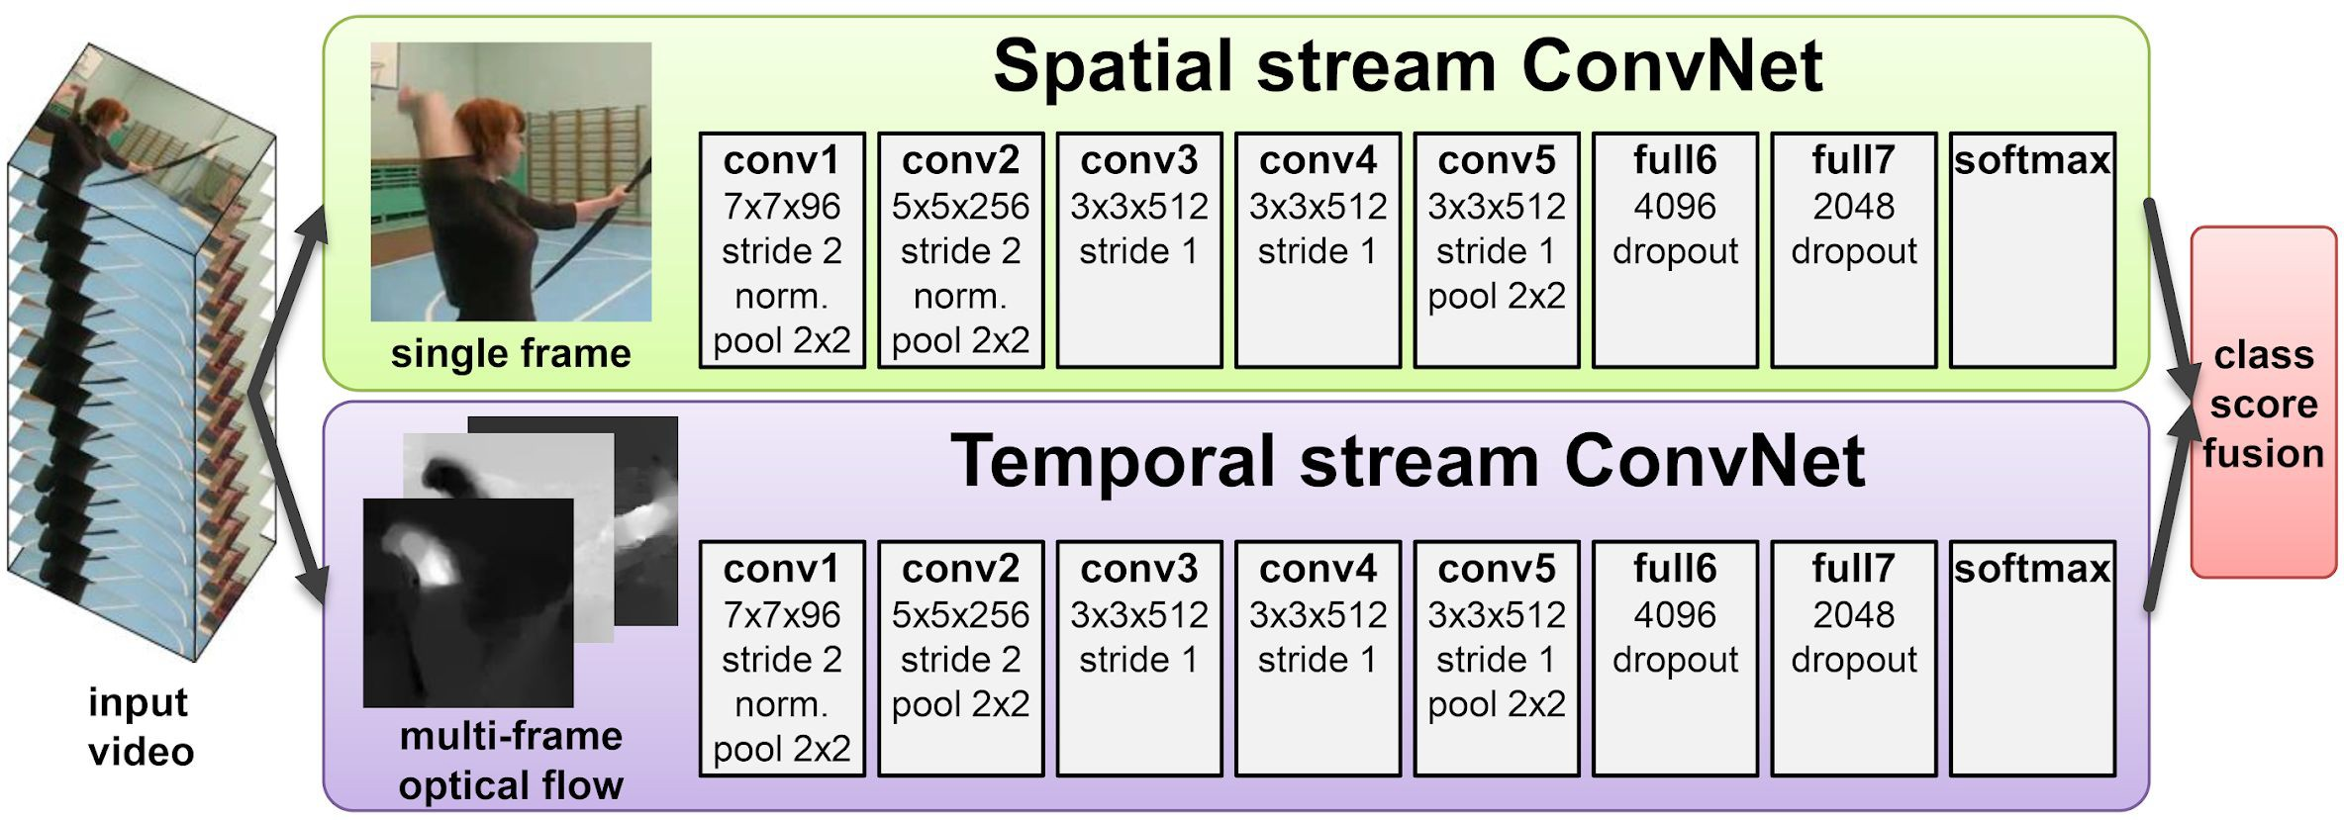
Separating Motion and Appearance: Two-Stream Networks
Input: Single Image 3 x H x W
Input: Stack of optical flow: [2*(T-1)] x H x W
Early fusion: First 2D conv processes all flow images
Simonyan and Zisserman, “Two-stream convolutional networks for action recognition in videos”, NeurIPS 2014
Fei-Fei Li, Yunzhu Li, Ruohan Gao

Slide 36
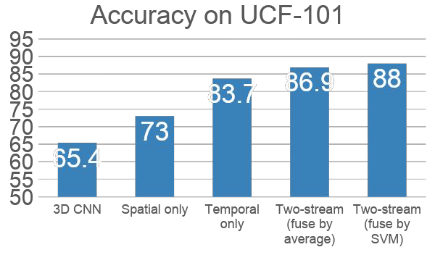
Separating Motion and Appearance: Two-Stream Networks
Simonyan and Zisserman, “Two-stream convolutional networks for action recognition in videos”, NeurIPS 2014
Fei-Fei Li, Yunzhu Li, Ruohan Gao

Slide 37
Modeling long-term temporal structure
So far all our temporal CNNs only model local motion between frames in very short clips of
~2-5 seconds. What about long-term structure?
First event
3D CNN
Second event
Time
May 4, 2023
~5 seconds

Slide 38
Modeling long-term temporal structure
So far all our temporal CNNs only model local motion between frames in very short clips of
~2-5 seconds. What about long-term structure?
We know how to handle sequences! How about recurrent networks?
First event
3D CNN
Second event
Time
May 4, 2023
~5 seconds

Slide 39
Modeling long-term temporal structure
Extract features with CNN (2D or 3D)
CNN
CNN
CNN
CNN
CNN
Time
May 4, 2023

Slide 40
Modeling long-term temporal structure
Process local features using recurrent network (e.g. LSTM)
Extract features with CNN (2D or 3D)
CNN
CNN
CNN
CNN
CNN
Time
May 4, 2023

Slide 41
Modeling long-term temporal structure
Process local features using recurrent network (e.g. LSTM) Many to one: One output at end of video
Extract features with CNN (2D or 3D)
CNN
CNN
CNN
CNN
CNN
Time
May 4, 2023

Slide 42
Modeling long-term temporal structure
Process local features using recurrent network (e.g. LSTM) Many to many: one output per video frame
Extract features with CNN (2D or 3D)
CNN
CNN
CNN
CNN
CNN
Time
May 4, 2023

Slide 43
Modeling long-term temporal structure
Sometimes don’t backprop to CNN to save memory; pretrain and use it as a feature extractor
Extract features with CNN (2D or 3D)
CNN
CNN
CNN
CNN
CNN
Baccouche et al, "Sequential Deep Learning for Human Action Recognition”, 2011
Donahue et al, “Long-term recurrent convolutional networks for visual recognition and description”, CVPR 2015
Time
May 4, 2023

Slide 44
Modeling long-term temporal structure
Inside CNN: Each value is a function of a fixed temporal window (local temporal structure) Inside RNN: Each vector is a function of all previous vectors (global temporal structure) Can we merge both approaches?
Extract features with CNN (2D or 3D)
CNN
CNN
CNN
CNN
CNN
Baccouche et al, "Sequential Deep Learning for Human Action Recognition”, 2011
Donahue et al, “Long-term recurrent convolutional networks for visual recognition and description”, CVPR 2015
Time
May 4, 2023

Slide 45
Recall: Multi-layer RNN
Three-layer RNN
y₀
y₁
y₂
y₃
y₄
y₅
y₆
_{h}3
_{h}3 3 3
₁ h ₂ h
_{h}3
_{h}3
_{h}3
0
3
4
5
6
We can use a similar structure to process videos!
_{h}2
_{h}2
_{h}2
_{h}2
_{h}2
_{h}2
_{h}2
0
1
2
3
4
5
6
_{h}1
_{h}1
_{h}1
_{h}1
_{h}1
_{h}1
_{h}1
0
1
2
3
4
5
6
depth
x₀
x₁
x₂
x₃
x₄
x₅
x₆
time
Lecture 10 -
May 4, 2023

Slide 46
Recurrent Convolutional Network
Entire network uses 2D feature maps: C x H x W
Layer 3
Each depends on two inputs:
Same layer, previous timestep
Prev layer, same timestep
Layer 2
Layer 1
Use different weights at each layer, share weights across time
Ballas et al, “Delving Deeper into Convolutional Networks for Learning Video Representations”, ICLR 2016
2D conv
2D conv
2D conv
2D conv

Slide 47
Recurrent Convolutional Network
Normal 2D CNN:
2D Conv
Input features: C x H x W
Output features: C x H x W

Slide 48
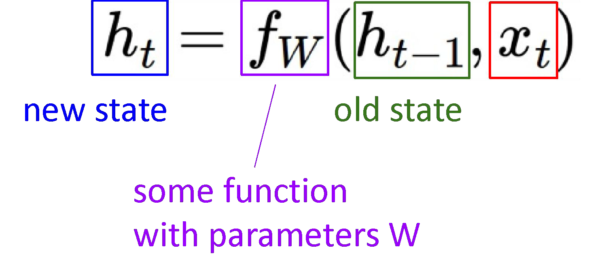



Recurrent Convolutional Network
Recall: Recurrent Network
Features from layer L, timestep t-1
RNN-like recurrence
Features for layer L, timestep t
Features from layer L-1, timestep t
Ballas et al, “Delving Deeper into Convolutional Networks for Learning Video Representations”, ICLR 2016
Fei-Fei Li, Yunzhu Li, Ruohan Gao

Slide 49
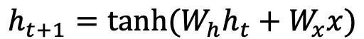
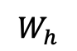


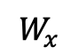
Recurrent Convolutional Network
Recall: Vanilla RNN
2D Conv
Replace all matrix multiply with 2D convolution!
Features from layer L, timestep t-1
+
tanh
2D Conv
Features for layer L, timestep t
Features from layer L-1, timestep t
Ballas et al, “Delving Deeper into Convolutional Networks for Learning Video Representations”, ICLR 2016
Fei-Fei Li, Yunzhu Li, Ruohan Gao

Slide 50
Modeling long-term temporal structure
Recurrent CNN: Infinite temporal extent (convolutional)
RNN: Infinite temporal extent (fully-connected)
CNN: finite temporal extent (convolutional)
Recurrent CNN
Recurrent CNN
CNN
CNN
Time
Time
Baccouche et al, "Sequential Deep Learning for Human Action Recognition”, 2011
Donahue et al, “Long-term recurrent convolutional networks for visual recognition and description”, CVPR 2015
Ballas et al, “Delving Deeper into Convolutional Networks for Learning Video Representations”, ICLR 2016

Slide 51
Modeling long-term temporal structure
Problem: RNNs are slow for long
sequences (can’t be parallelized)
RNN: Infinite
Recurrent CNN: Infinite temporal extent (convolutional)
temporal extent (fully-connected)
CNN: finite temporal extent (convolutional)
Recurrent CNN
Recurrent CNN
CNN
CNN
Time
Time
Baccouche et al, "Sequential Deep Learning for Human Action Recognition”, 2011
Donahue et al, “Long-term recurrent convolutional networks for visual recognition and description”, CVPR 2015
Ballas et al, “Delving Deeper into Convolutional Networks for Learning Video Representations”, ICLR 2016

Slide 52
Inflating 2D Networks to 3D (I3D)
There has been a lot of work on architectures for images. Can we reuse image architectures for video?
Idea: take a 2D CNN architecture.
Replace each 2D K_{h} x K_{w} conv/pool layer with a 3D K_{t} x K_{h} x K_{w} version
Carreira and Zisserman, “Quo Vadis, Action Recognition? A New Model and the Kinetics Dataset”, CVPR 2017
Fei-Fei Li, Yunzhu Li, Ruohan Gao

Slide 53
Inflating 2D Networks to 3D (I3D)
There has been a lot of work on architectures for images. Can we reuse image architectures for video?
Idea: take a 2D CNN Inception Block: Original architecture.
Concatenate
Replace each 2D K_{h} x K_{w} conv/pool layer with a 3D K_{t} x K_{h} x K_{w} version
3x3 Conv
1x1 Conv
5x5 Conv
1x1 Conv
1x1 Conv
3x3 MaxPool
1x1 Conv
Previous layer
Carreira and Zisserman, “Quo Vadis, Action Recognition? A New Model and the Kinetics Dataset”, CVPR 2017
Fei-Fei Li, Yunzhu Li, Ruohan Gao

Slide 54
Inflating 2D Networks to 3D (I3D)
There has been a lot of work on architectures for images. Can we reuse image architectures for video?
Idea: take a 2D CNN Inception Block: Inflated architecture.
Concatenate
Replace each 2D K_{h} x K_{w} conv/pool layer with a 3D K_{t} x K_{h} x K_{w} version
5x5x5 Conv
3x3x3 Conv
1x1x1 Conv
1x1x1 Conv
1x1x1 Conv
1x1x1 Conv
3x3x3 MaxPool
Previous layer
Carreira and Zisserman, “Quo Vadis, Action Recognition? A New Model and the Kinetics Dataset”, CVPR 2017
Fei-Fei Li, Yunzhu Li, Ruohan Gao

Slide 55
Inflating 2D Networks to 3D (I3D)
There has been a lot of work on architectures for images. Can we reuse image architectures for video?
Input: 2D conv kernel: 3 x H x W C_{in} x K_{h} x K_{w}
Output: H x W
Idea: take a 2D CNN architecture.
Replace each 2D K_{h} x K_{w} conv/pool layer with a 3D K_{t} x K_{h} x K_{w} version
Can use weights of 2D conv to initialize 3D conv: copy K_{t} times in space and divide by K_{t}
This gives the same result as 2D conv given “constant” video input
Duplicate input K_{t} times
Copy kernel K_{t} times, divide by K_{t}
Output is the same!
Input:
3D conv kernel:
Output:
3 x K_{t} x H x W
Carreira and Zisserman, “Quo Vadis, Action Recognition? A New Model and the Kinetics Dataset”, CVPR 2017
^{C}in
x K_{t} x K_{h} x K_{w}
1 x H x W

Slide 56
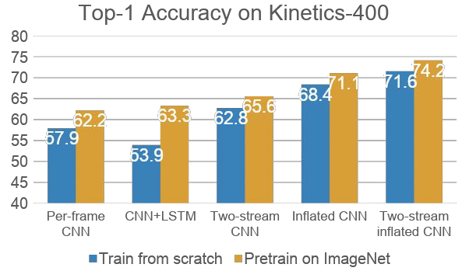
Inflating 2D Networks to 3D (I3D)
There has been a lot of work on architectures for images. Can we reuse image architectures for video?
Idea: take a 2D CNN architecture.
Replace each 2D K_{h} x K_{w} conv/pool layer with a 3D K_{t} x K_{h} x K_{w} version
Can use weights of 2D conv to initialize 3D conv: copy K_{t} times in space and divide by K_{t}
This gives the same result as 2D conv given “constant” video input
Carreira and Zisserman, “Quo Vadis, Action Recognition? A New Model and the Kinetics Dataset”, CVPR 2017
Fei-Fei Li, Yunzhu Li, Ruohan Gao

Slide 57
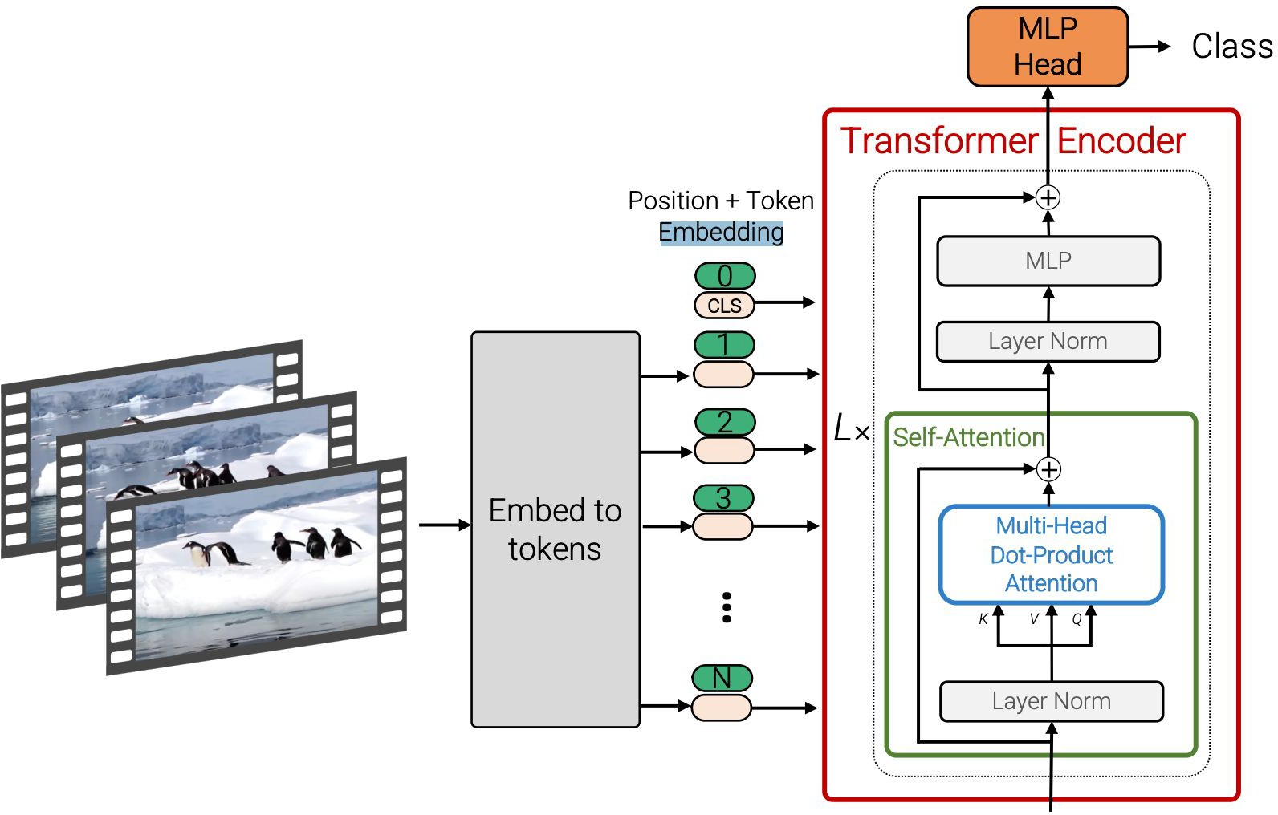
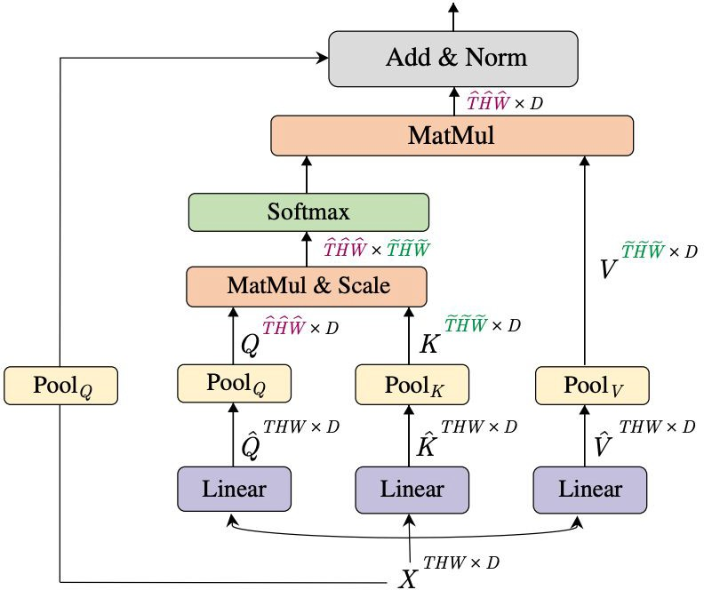
Vision Transformers for Video
Factorized attention: Attend over space / time Pooling module: Reduce number of tokens
Bertasius et al, “Is Space-Time Attention All You Need for Video Understanding?”, ICML 2021 Arnab et al, “ViViT: A Video Vision Transformer”, ICCV 2021
Neimark et al, “Video Transformer Network”, ICCV 2021
Fan et al, “Multiscale Vision Transformers”, ICCV 2021 Li et al, “MViTv2: Improved Multiscale Vision Transformers for
Classification and Detection”, CVPR 2022

Slide 58
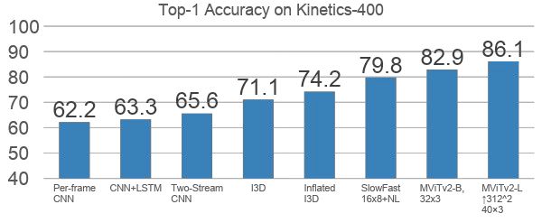
Vision Transformers for Video
Li et al, “MViTv2: Improved Multiscale Vision Transformers for Classification and Detection”, CVPR 2022
80

Slide 59
Visualizing Video Models
Image
Forward: Compute class score
”weightlifting” score
Flow
Backward: Compute gradient
Add a term to encourage spatially smooth flow; tune penalty to pick out “slow” vs “fast” motion
Figure credit: Simonyan and Zisserman, “Two-stream convolutional networks for action recognition in videos”, NeurIPS 2014
Feichtenhofer et al, “What have we learned from deep representations for action recognition?”, CVPR 2018 Feichtenhofer et al, “Deep insights into convolutional networks for video recognition?”, IJCV 2019.

Slide 60
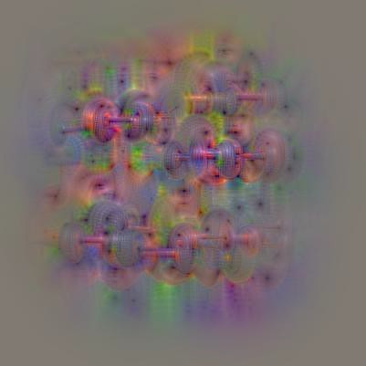
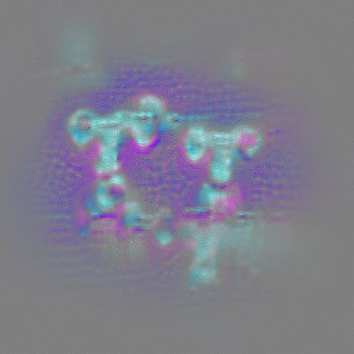
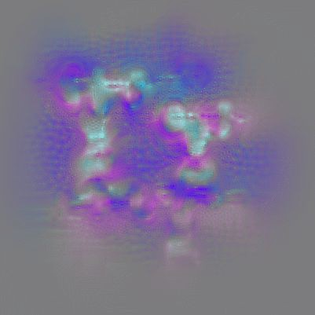
Can you guess the action?
Feichtenhofer et al, “What have we learned from deep representations for action recognition?”, CVPR 2018 Feichtenhofer et al, “Deep insights into convolutional networks for video recognition?”, IJCV 2019.
Slide credit: Christoph Feichtenhofers
Appearance “Slow” motion
“Fast” motion
Fast motion appearance

Slide 61
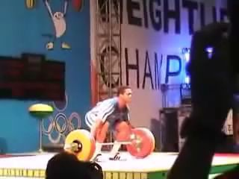
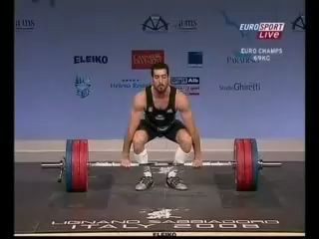
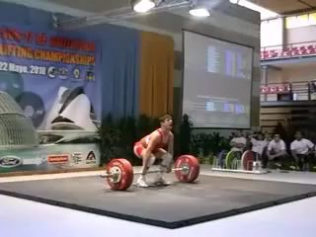
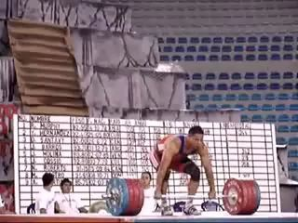
Can you guess the action?
Weightlifting
“Fast” motion
Appearance “Slow” motion
”Bar Shaking”
“Push overhead”
Fast motion appearance

Slide 62
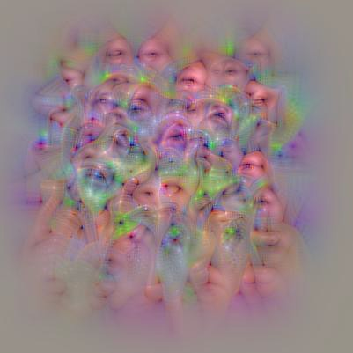

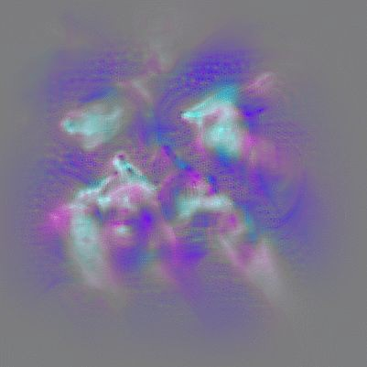
Can you guess the action?
Appearance “Slow” motion
“Fast” motion
”Bar Shaking”
“Push overhead”
Fast motion appearance
Fast motion appearance

Slide 63


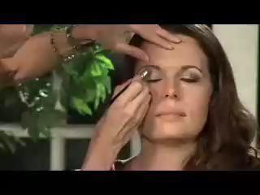

Can you guess the action?
Apply Eye Makeup
Appearance
“Slow” motion “Fast” motion
”Bar Shaking”
“Push overhead”
Fast motion appearance
Fast motion appearance

Slide 64
So far: Classify short clips
Swimming Running Jumping Eating Standing
Videos: Recognize actions

Slide 65
Temporal Action Localization
Given a long untrimmed video sequence, identify frames corresponding to different actions
Running Jumping
Can use architecture similar to Faster R-CNN: first generate temporal proposals then classify
Chao et al, ” Rethinking the Faster R-CNN Architecture for Temporal Action Localization”, CVPR 2018
87
May 4, 2023

Slide 66
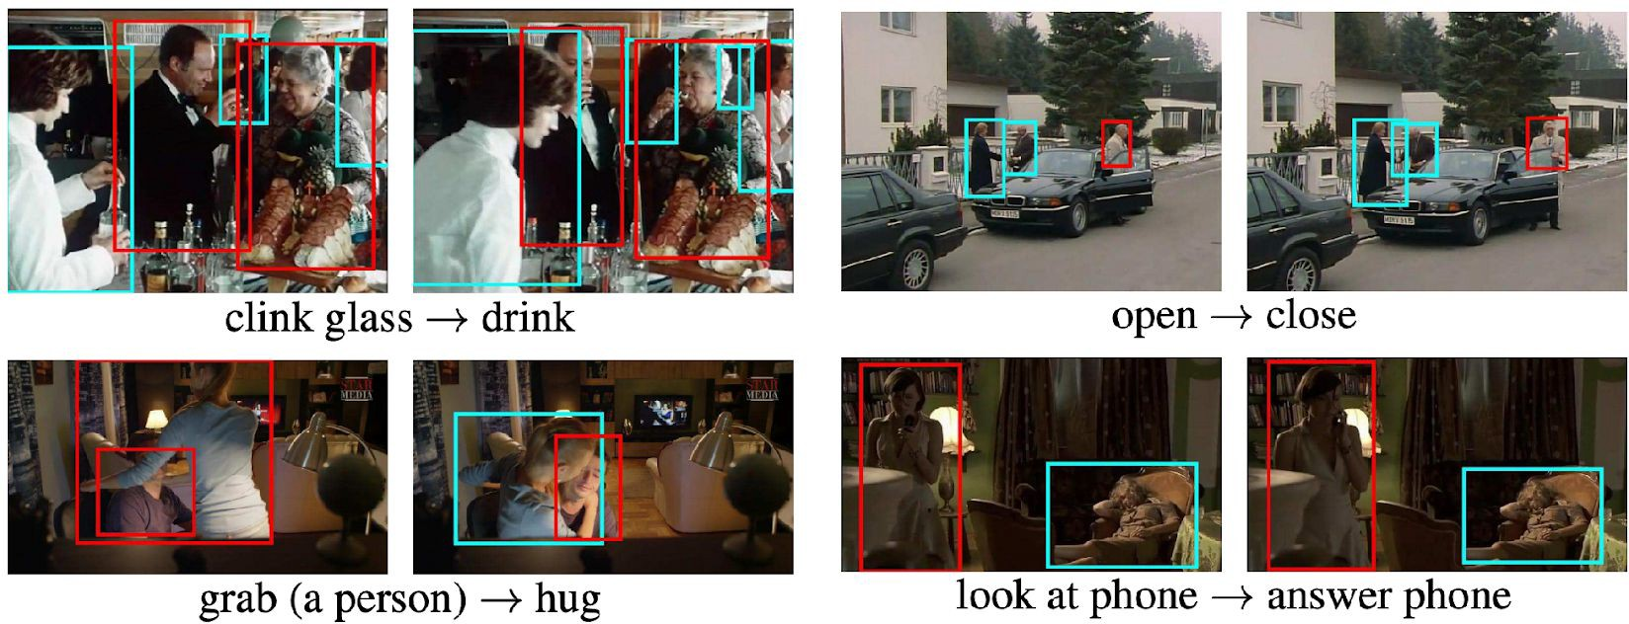
Spatio-Temporal Detection
Given a long untrimmed video, detect all the people in both space and time and classify the activities they are performing. Some examples from AVA Dataset:
Gu et al, “AVA: A Video Dataset of Spatio-temporally Localized Atomic Visual Actions”, CVPR 2018
May 4, 2023

Slide 67
Today: Temporal Stream
…
…
3D CNN, Two-Stream Neural Network, Spatial-Temporal Self-Attention……
May 4, 2023

Slide 68
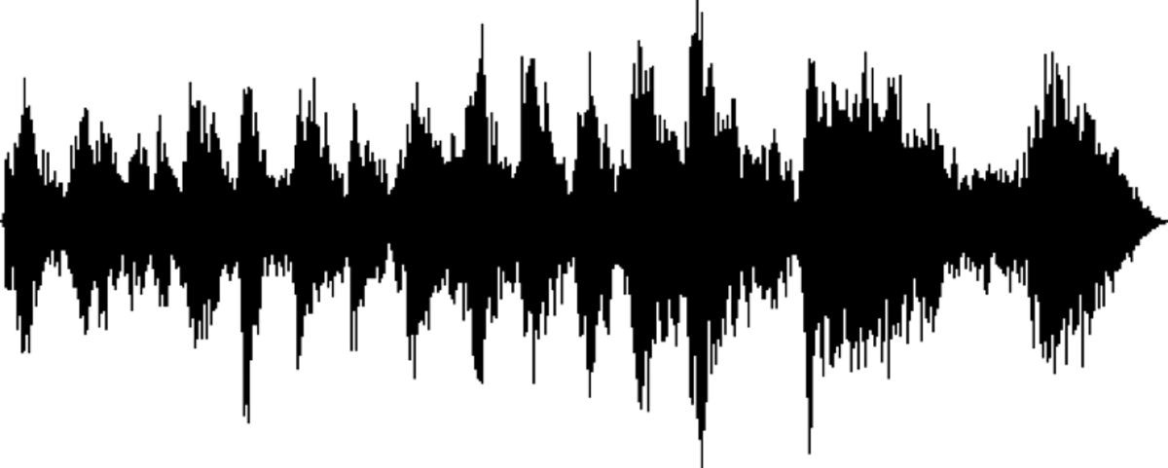
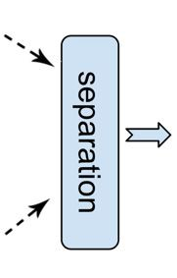
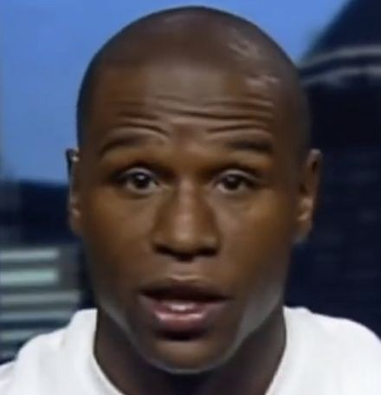
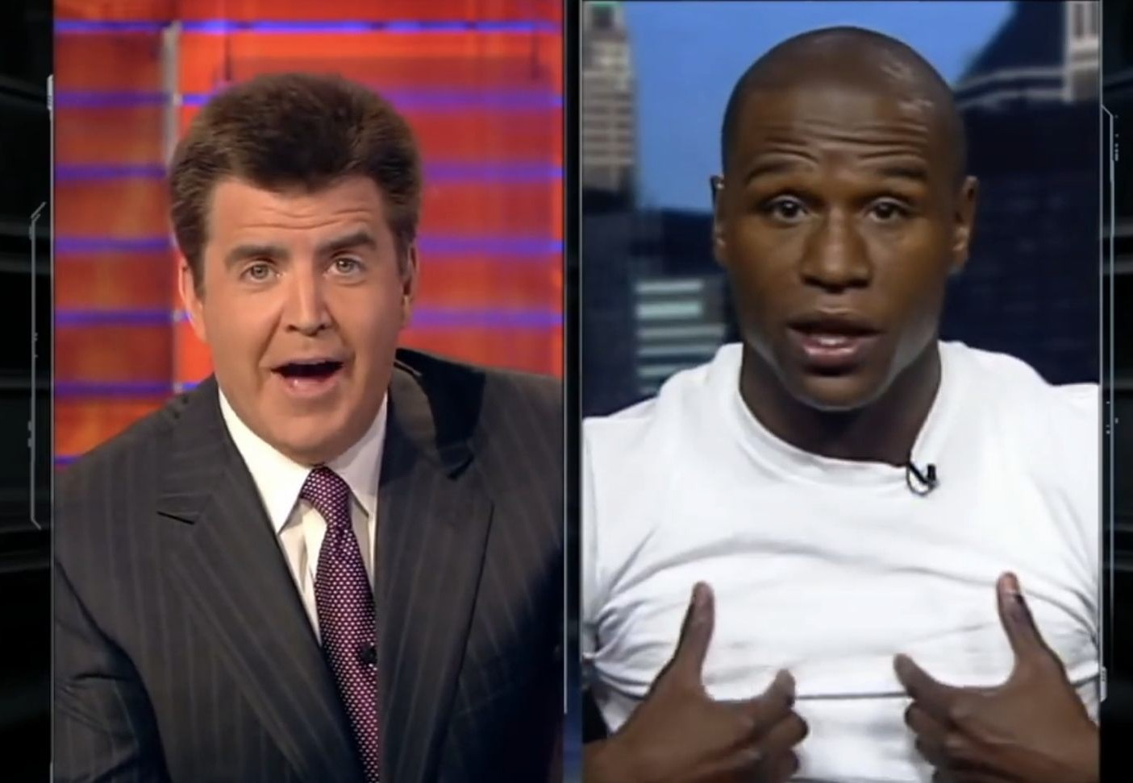
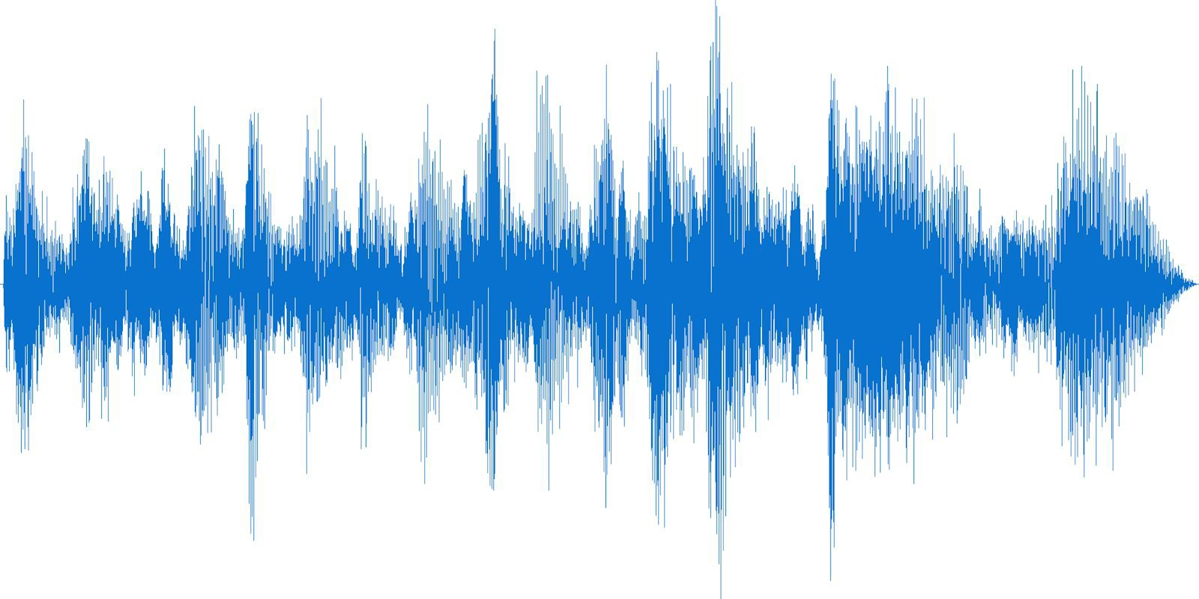


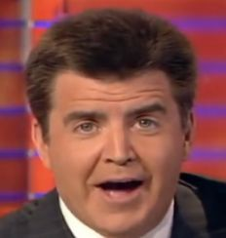
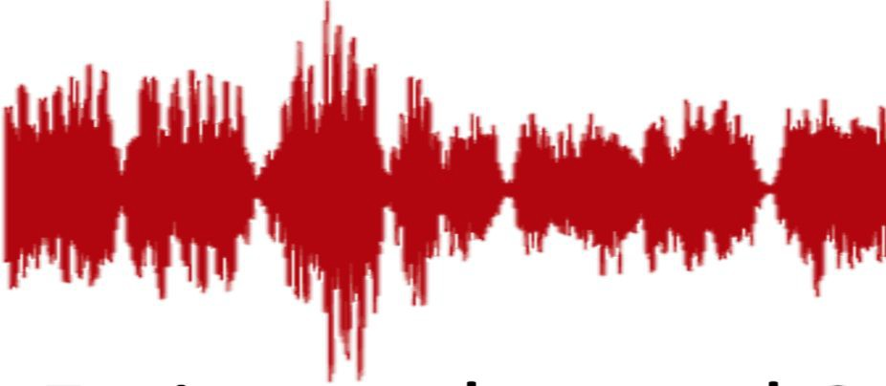

Visually-guided audio source separation
[Gao et al. ECCV 2018, Afouras et al. Interspeech’18, Gabby et al. Interspeech’18, Owens & Efros ECCV’18, Ephrat et al. SIGGRAPH’18, Zhao et al. ECCV 2018, Gao & Grauman ICCV 2019, Zhao et al. ICCV 2019, Xu et al. ICCV 2019, Gan et al. CVPR 2020, Gao et al. CVPR 2021]
Fei-Fei Li, Yunzhu Li, Ruohan Gao
Lecture 10 - 94 May 4, 2023

Slide 69


Musical instruments source separation
Train on 100,000 unlabeled multi-source video clips, then separate audio for novel video.
Gao & Grauman, Co-Separating Sounds of Visual Objects, ICCV 2019
May 4, 2023

Slide 70






























Audio as a preview mechanism for efficient action recognition in untrimmed videos
Image feature
Fusion layer
Fusion layer
LSTM
LSTM
Audio feature
Gao et al., Listen to Look: Action Recognition by Previewing Audio, CVPR 2020
May 4, 2023

Slide 71



Multimodal Video Understanding
Attention Bottlenecks for Multimodal Fusion, Nagrani et al. NeurIPS 2021
EPIC-Fusion: Audio-Visual Temporal Binding for Egocentric Action Recognition, Kazakos et al., ICCV 2019
Audio-Adaptive Activity Recognition Across Video Domains, Yunhua et al. CVPR 2022
100
May 4, 2023100

Slide 72










Learning audio-visual synchronization
Owens & Efros, Audio-visual scene analysis with self-supervised multisensory features, ECCV 2018
Korbar et al., Co-training of audio and video representations from self-supervised temporal synchronization, NeurIPS 2018
May 4, 2023

Slide 73

Learning audio-visual synchronization
Owens & Efros, Audio-visual scene analysis with self-supervised multisensory features, ECCV 2018
May 4, 2023

Slide 74


Learning audio-visual synchronization
Motion
Loudness
Time
May 4, 2023

Slide 75







Learning audio-visual synchronization
Aligned vs. misaligned
3D Convolution
3D Convolution 3D Convolution
3D Convolution
1D Convolution
1D Convolution
1D Convolution
Owens & Efros, Audio-visual scene analysis with self-supervised multisensory features, ECCV 2018
May 4, 2023

Slide 76

Top responses in test set
Owens & Efros, Audio-visual scene analysis with self-supervised multisensory features, ECCV 2018
May 4, 2023

Slide 77

Sound source localization
Owens & Efros, Audio-visual scene analysis with self-supervised multisensory features, ECCV 2018 Arandjelović and Zisserman, ECCV 2018; Senocak et al. CVPR 2018; Kidron et al. CVPR 2005 …
May 4, 2023

Slide 78
Next time: Image Segmentation
May 4, 2023

